Slide 1


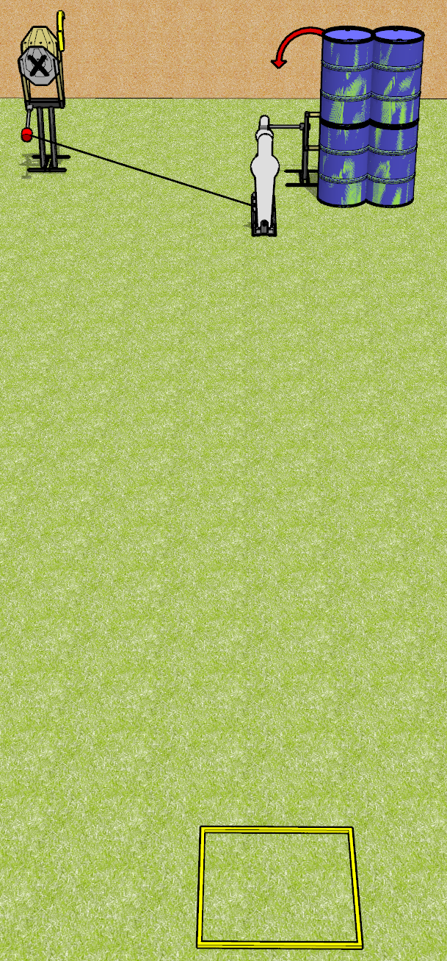
 | Dothan Gun Club – USPSA Match Just For Fun Course Designer : Drew Coleman
Round Count 8 Rounds 2 IPSC 1 pepper, 1 mini
Equipment List Max trap + activator Swinger Shooting box

Slide 2
Just For Fun
Written Stage Briefing
Just For Fun is an 8 round, 40 point, Comstock speed shoot. There are 2 IPSC targets and 2 steel. The best 3 hits on cardboard will score and steel must fall to score.
The max trap is activated by P1 and is a disappearing target. The swinger is activated by P2 and remains visible at rest
Handgun start position is anywhere inside the shooting area, wrists below belt. Handgun is loaded and holstered.
PCC start position is anywhere inside the shooting area, stock on belt. Loaded carbine is held with both hands, safety on.
On the audible start signal, engage targets as they become available from within the shooting area.

Slide 3
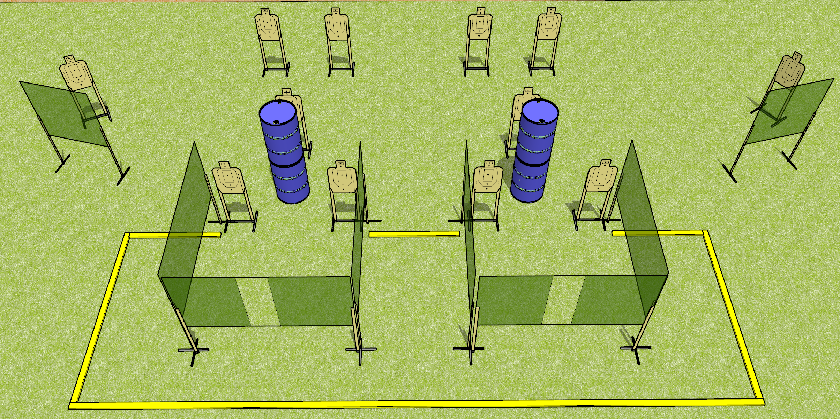
 | Dothan Gun Club – USPSA Match Just Open Targets Course Designer : Drew Coleman
Round Count 24 rounds 12 USPSA
Equipment List 3 medium fault lines 12 wall feet

Slide 4
Just Open Targets
Written Stage Briefing
Just Open Targets is a 24 round, 120 point, Comstock course of fire. There are 12 USPSA targets. The best 2 hits will score.
Handgun start position is anywhere inside the shooting area, wrists below belt. Handgun is loaded and holstered.
PCC start position is anywhere inside the shooting area, stock on belt. Loaded carbine is held with both hands, safety on.
On audible start signal, engage targets as they become available from within the shooting area.

Slide 5
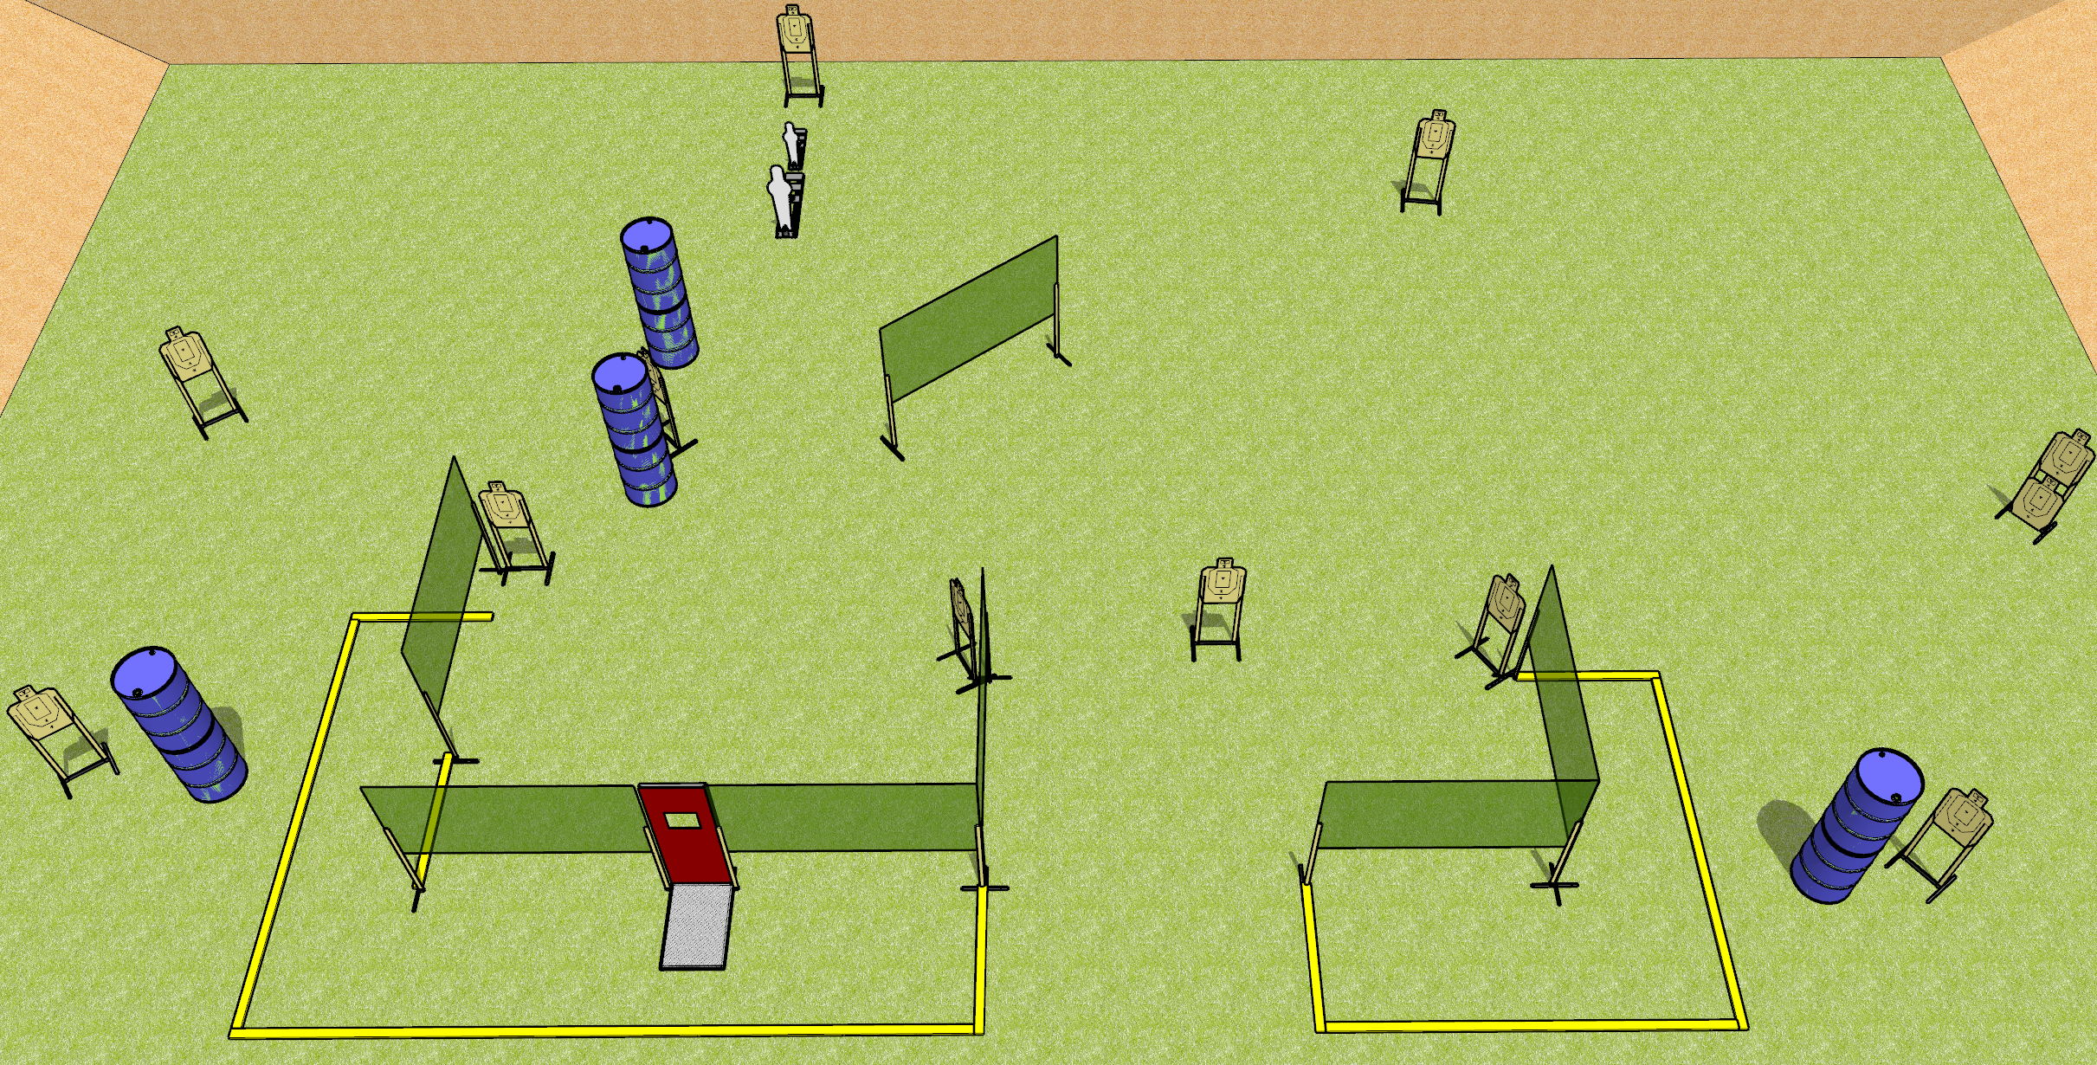
 | Dothan Gun Club – USPSA Match Get Out There Course Designer : Drew Coleman
Round Count 26 rounds 12 USPSA 1 pepper, 1 mini
Equipment List 4 medium fault lines 12 wall feet Pull cord prop

Slide 6
Get Out There
Written Stage Briefing
Get Out There is a 26 round, 130 point, Comstock course of fire. There are 12 USPSA targets and 2 steel. The best 2 hits on cardboard will score, and steel must fall to score.
Handgun start position is anywhere inside the shooting area, wrists below belt. Handgun is loaded and holstered.
PCC start position is anywhere inside the shooting area, stock on belt. Loaded carbine is held with both hands, safety on.
On the audible start signal, engage targets as they become available from within the shooting area.

Slide 7
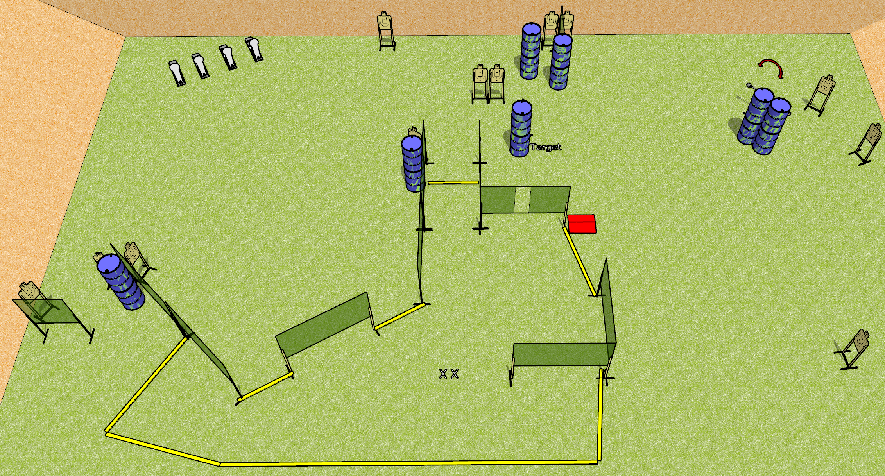
 | Dothan Gun Club – USPSA Match Running Around Course Designer : Drew Coleman
Round Count 32 rounds 14 USPSA 4 colt poppers
Equipment List 3 medium fault lines 18 wall feet Swinger + stomp pad

Slide 8
Running Around
Written Stage Briefing
Running Around is a 32 round, 160 point, Comstock course of the fire. There are 14 USPSA targets and 4 steel. The best 2 hits on cardboard will score and steel must fall to score.
The swinger is activated by the stomp pad and remains visible at rest.
Handgun start position is feet on X’s, wrists below belt. Handgun is loaded and holstered.
PCC start position is feet on X’s, stock on belt. Loaded carbine is held with both hands, safety on.
On the audible start signal, engage targets as they become available from within the shooting area.

Slide 9
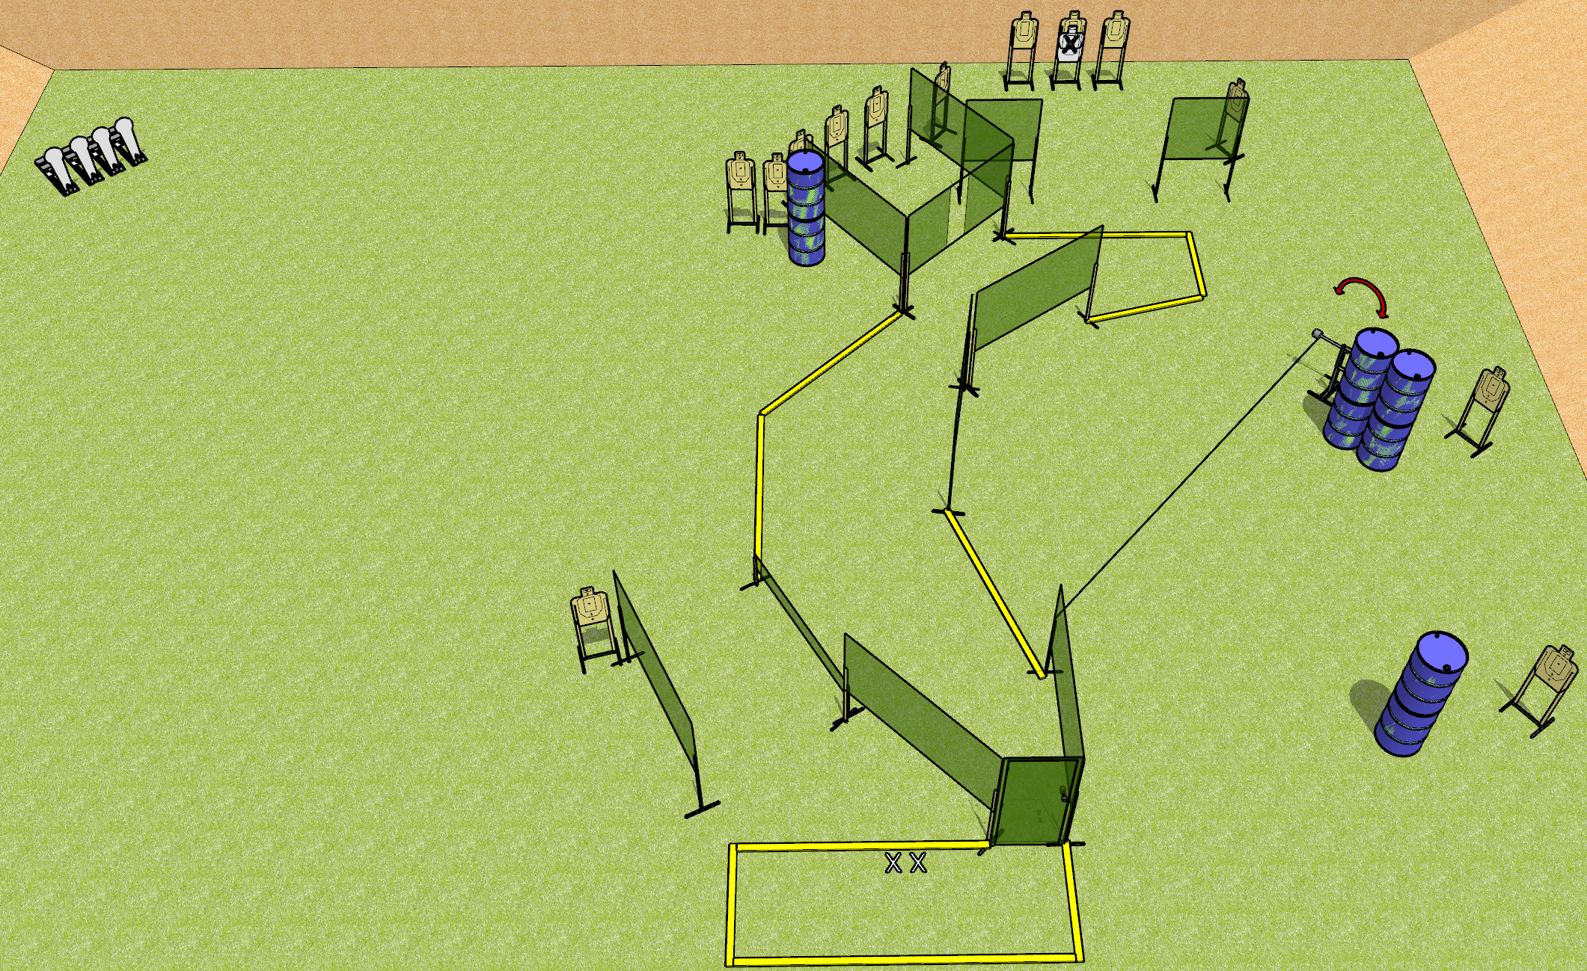
 | Dothan Gun Club – USPSA Match Doorway To The Fun Zone Course Designer : Drew Coleman
Round Count 32 rounds 14 USPSA 4 colt poppers
Equipment List 1 swinger + door + activator + wall with eyelet 4 medium fault lines 15 targets (14 score + 1 NS) Low wall

Slide 10
Doorway To The Fun Zone
Written Stage Briefing
Doorway To The Fun Zone is a 32 round, 160 point, Comstock course of fire. There are 14 USPSA targets and 4 colt poppers. The best 2 hits on cardboard will score and steel must fall to score.
The swinger is activated by the door and remains visible at rest.
Handgun start position is feet on X’s, wrists below belt. Handgun is loaded and holstered.
PCC start position is feet on X’s, stock on belt. Loaded carbine is held with both hands, safety on.
On the audible start signal, engage targets as they become available from within the shooting area.

